Slide 1
Fashion trends Data Science Project Presentation
Presented By: Onoja Itodo

Slide 2
What’s the meaning of this?
About my Project:
In this project, I’m going to be using data python packages such as pandas, numpy, matplotlib, and seaborn to analyze a fashion clothing projects database from myntra.com. Myntra is a major indian fashion e-commerce company headquartered in Bengaluru, Karnataka. India; founded in 2007 to sell personalized gift items.
Purpose:
To get a sense of the buying habits of consumers in a different region.
To analyze what would make specific items sell more than others.
To see what biases may or may not exist when fashion brands are marketing their clothing to consumers.
Determining the parameters that could make or break the worth of clothing in a foreign region.

Slide 3
Table of contents
Q1
Q2
Q3
Question
Question
Question
What were the most expensive purchases?
How did the colors of certain pieces correlate to the sales of items?
What were the most common brand purchases?

Slide 4
Q1
Question
What were the most expensive purchases?

Slide 5
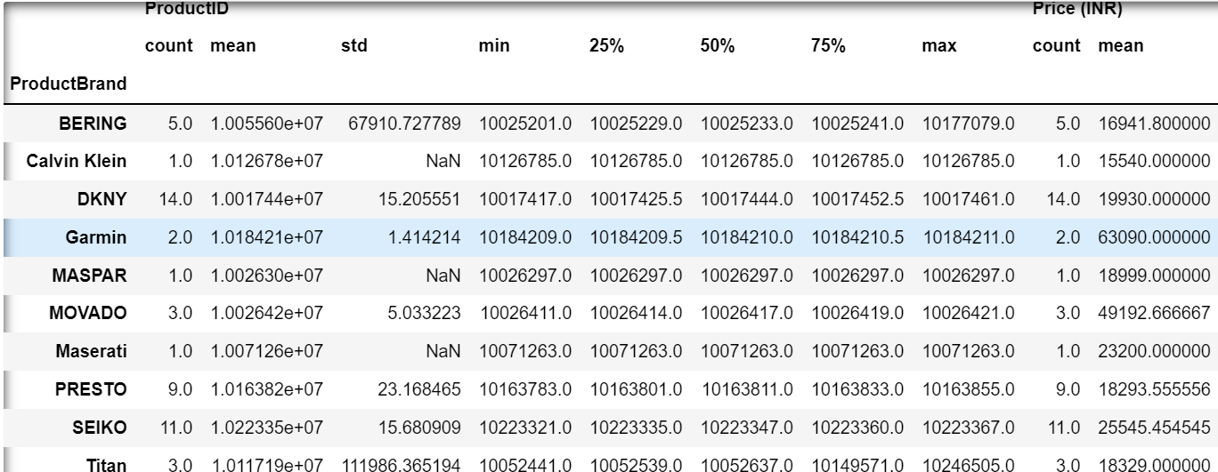
How I found the most expensive purchases
The most expensive brands purchased were BERING, Calvin Klein, DKNY, Garmin, MASPAR, MOVADO, Maserati, PRESTO, SEIKO, and Titan
I found this by coding my database to view the top 50 most expensive items out of over 12,000 purchases.
Then grouping those purchases by brand. Which gave me the table to the right.

Slide 6
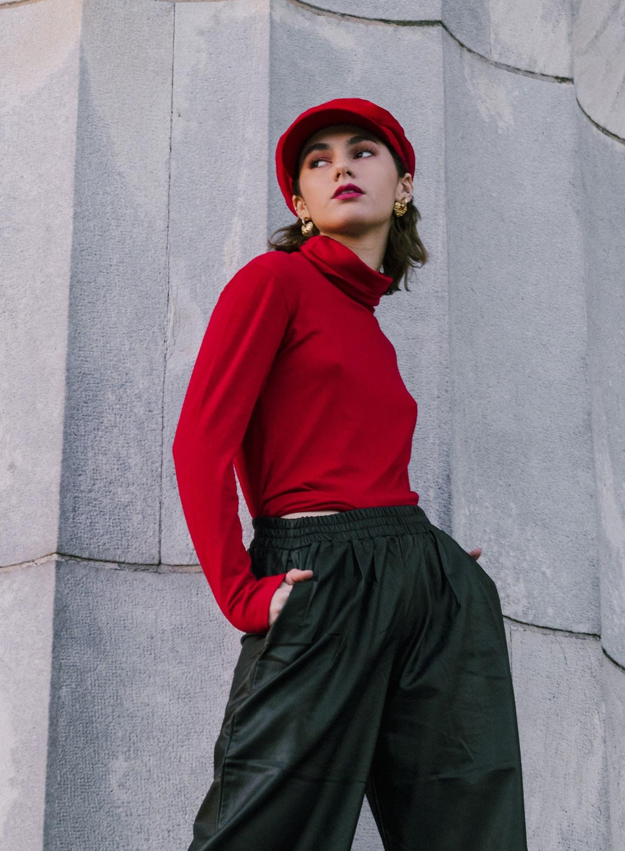
Q2
Question
How did the colors of certain pieces correlate to the sales of items?

Slide 7
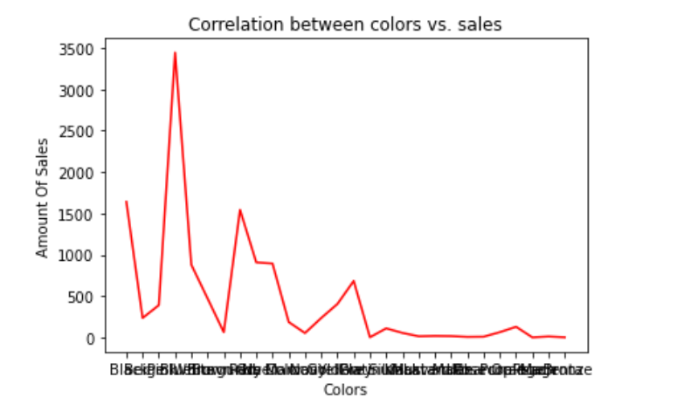
This is what I found….
28%
Of the clothes sold were blue.
13%
Of the colors sold were black.
12%
Of the colors sold were red.
I created the plot by making a dictionary with the keys being the colors(x) and values being the number of purchases(y), then using matplotlib to plot a line graph.
If you want to modify this graph, click on it, follow the link, change the data and replace it

Slide 8

Q3 Question What were the most common brand purchases?

Slide 9
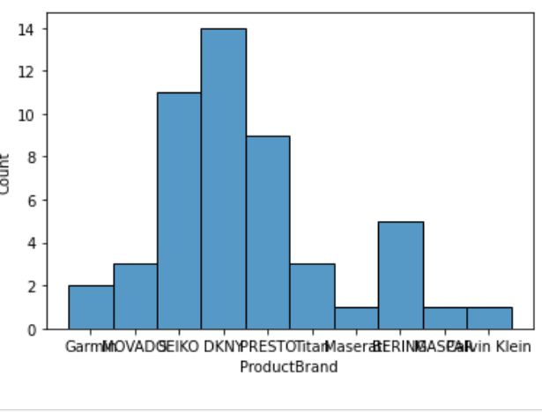
What my data showed me…. DKNY ended up being the most bought item. I found this by finding the mode of all the purchases in this database using the .mode() command. Then made a bar plot to visually represent the difference in sales to other competitors.

Slide 10
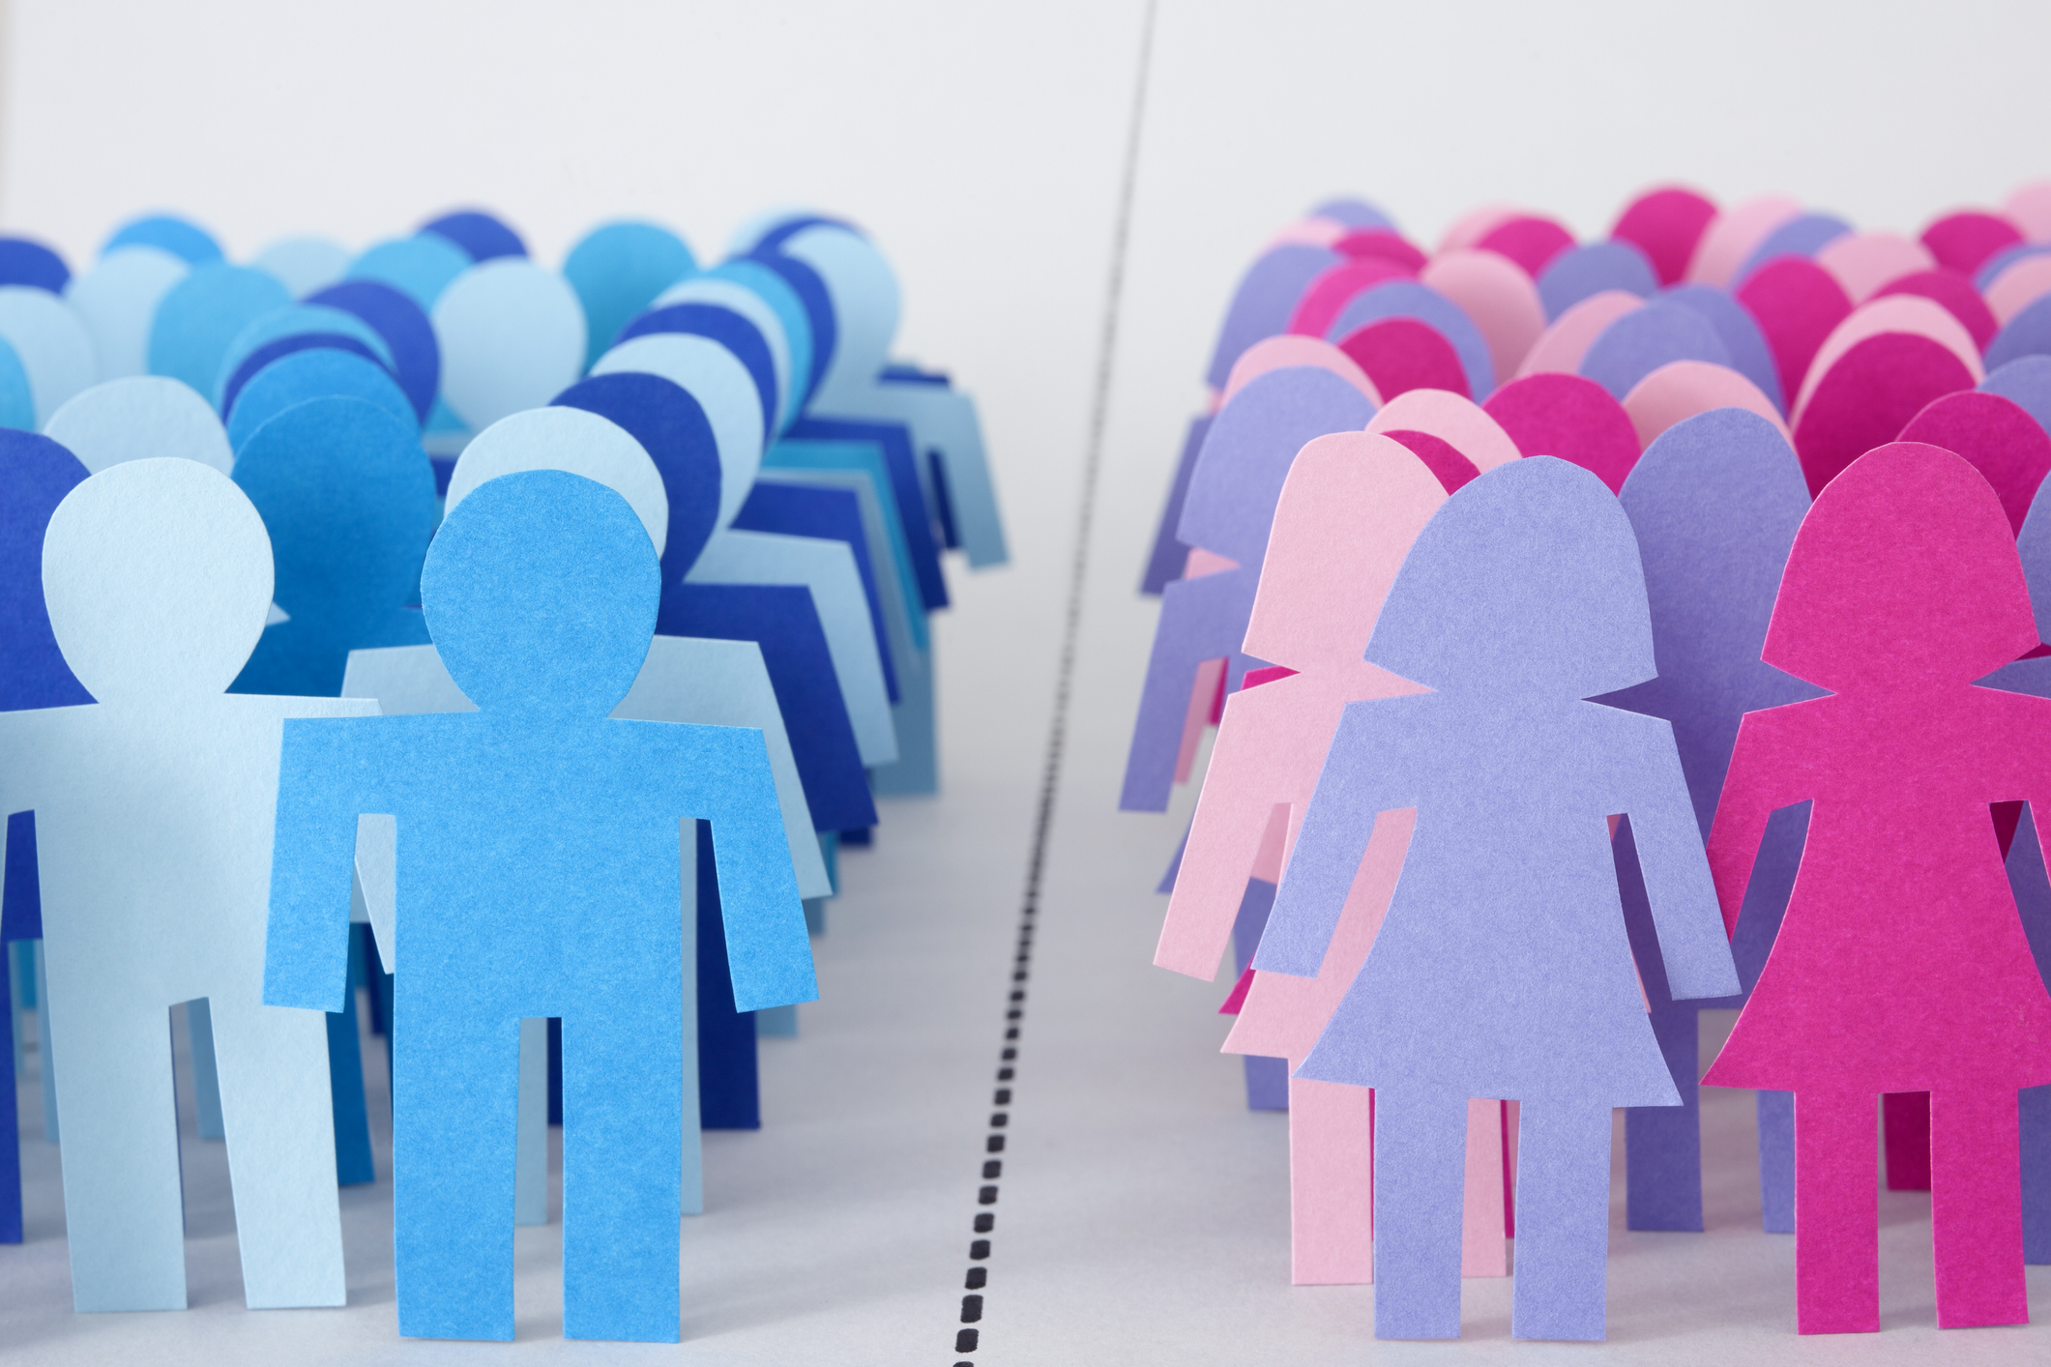
Q4 Question How did one’s gender affect the price of clothing?

Slide 11
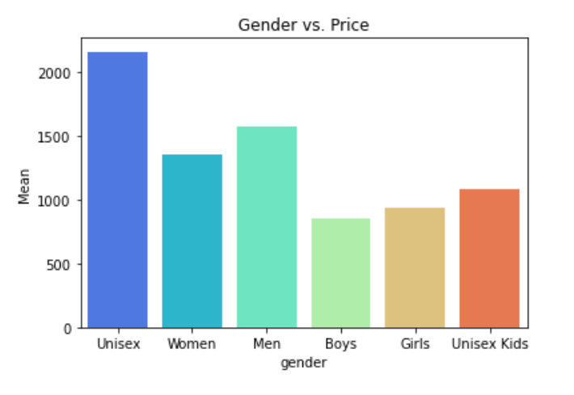
I found this out by…
Grouping my dataset by gender, finding the mean price of the clothing for each category. Then making a seaborn bar plot showcasing the results.
As you can see, unisex clothing had the greatest average price.

Slide 12

Q5 Question What was the importance that color and gender played, with either the price or sales?

Slide 13
What I noticed…
As you can see from the graphs, when talking about the price of clothing gender played more of a deciding factor, however colors proved most important with the overall sales of the clothing. It’s really a quantity vs. quality decision for the buyers.

Slide 14
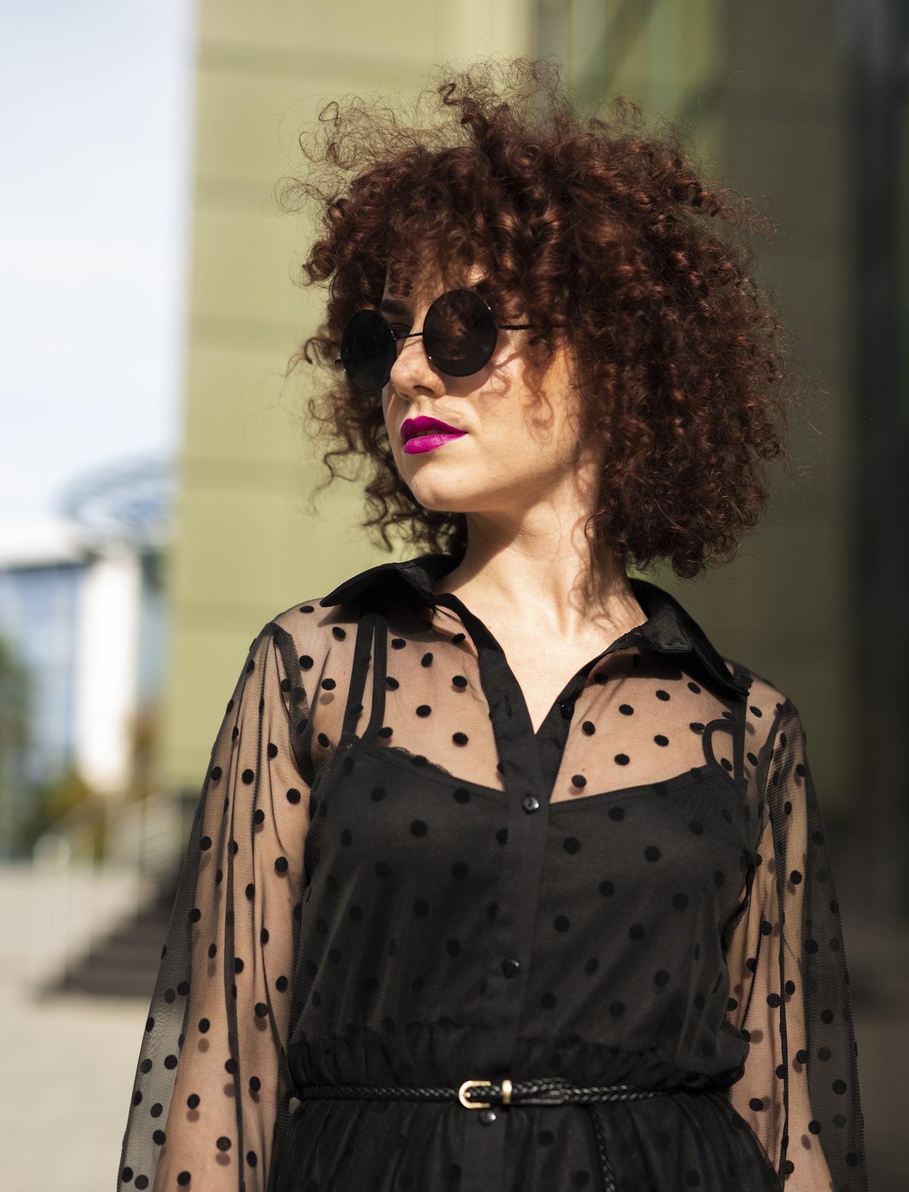
What I learned?
A lot of people in Indian fashion markets don’t really go for outlandish colors
There was a strong correlation between the price of items & gender of the consumer.
Only specific western fashion brands are popular to indian consumers.

Slide 15
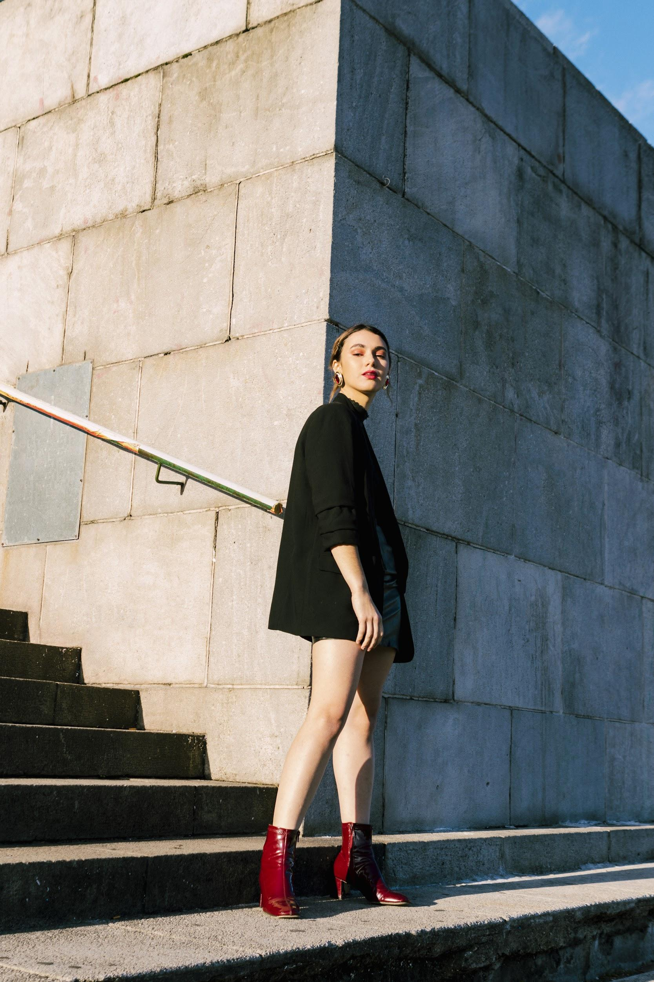
Thanks
Do you have any questions?

